Slide 1
SLAM Line
Guard Rail System
Engineering Design Report
Johnny Poole | AMM Intern
TPA4-SFC — Temple Terrace, FL | August 2026
Notes:
Title slide. Project: SLAM Line Guard Rail System at TPA4-SFC. Presenter: Johnny Poole, AMM Intern, RME Engineering.

Slide 2
AGENDA
Problem &
Impact
Design &
Analysis
Results
& ROI
Looking
Ahead
1
3
5
7
2
4
6
The
Numbers
Assembly and Installation
Configuration
Tool
Notes:
Agenda with flowing serpentine roadmap.

Slide 3
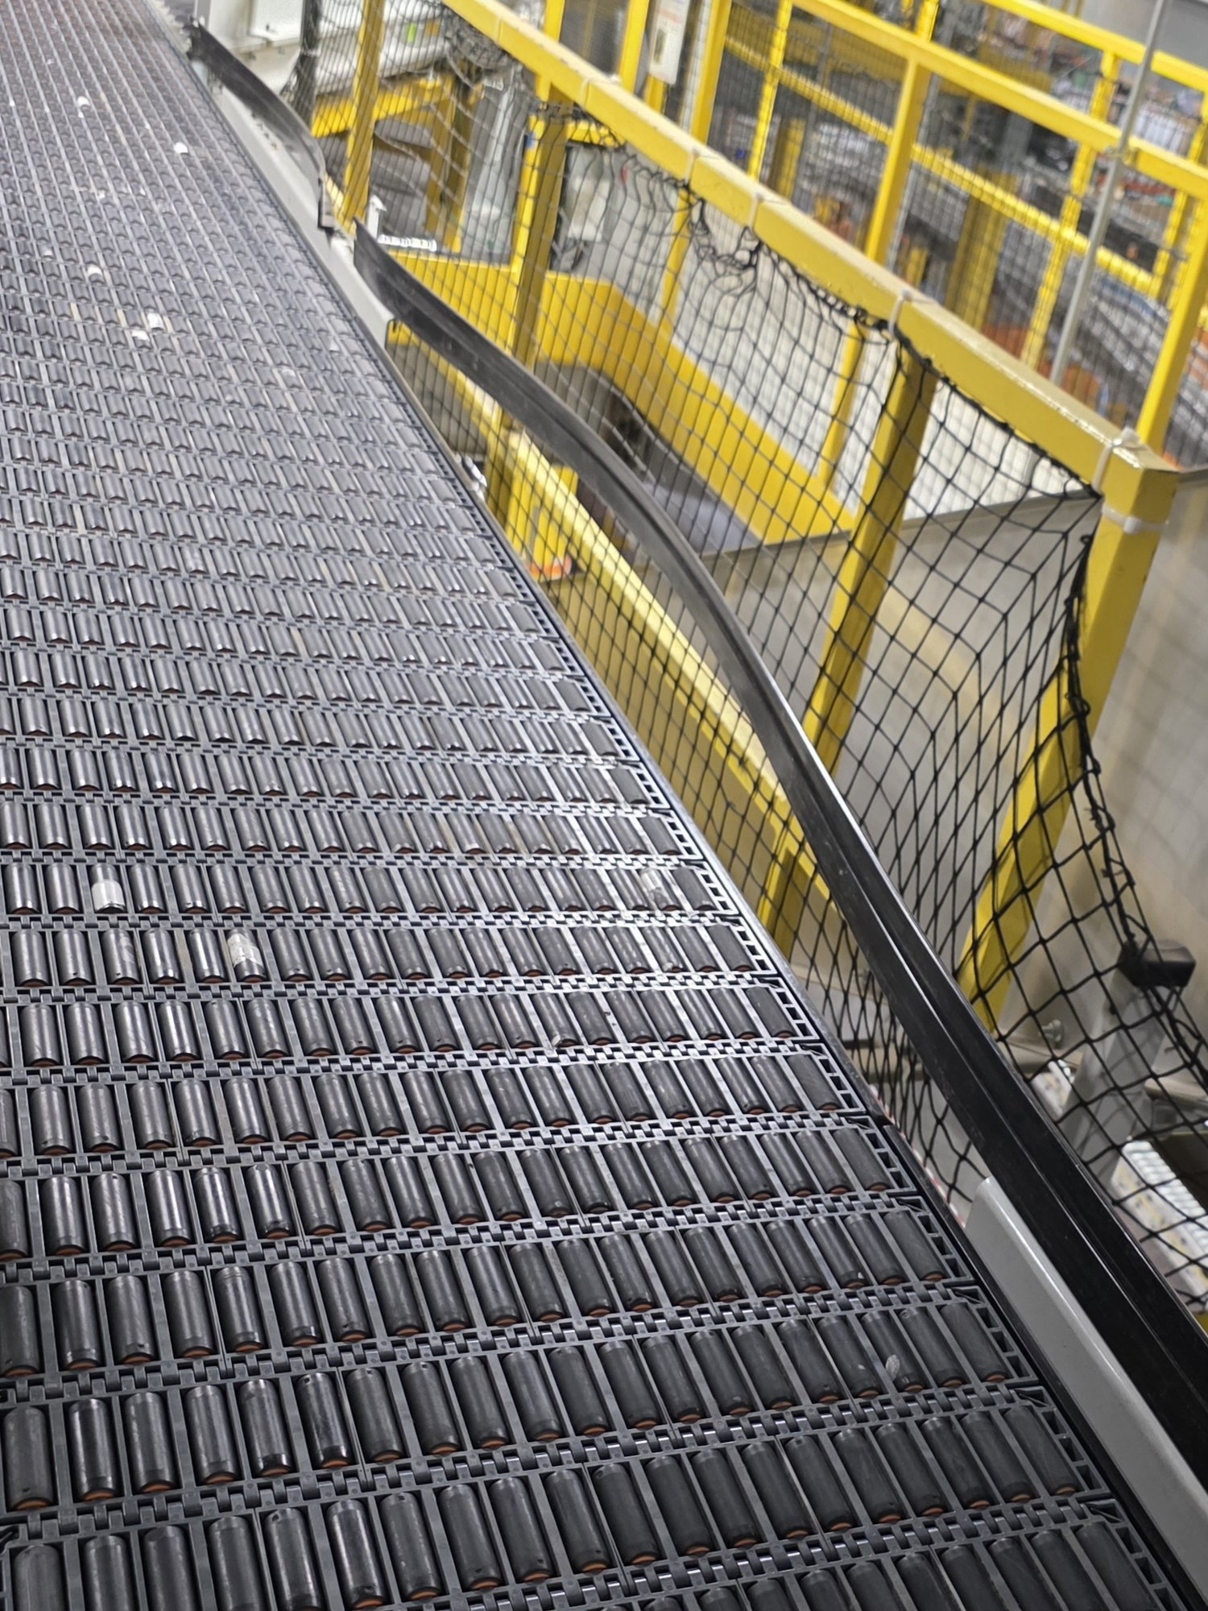
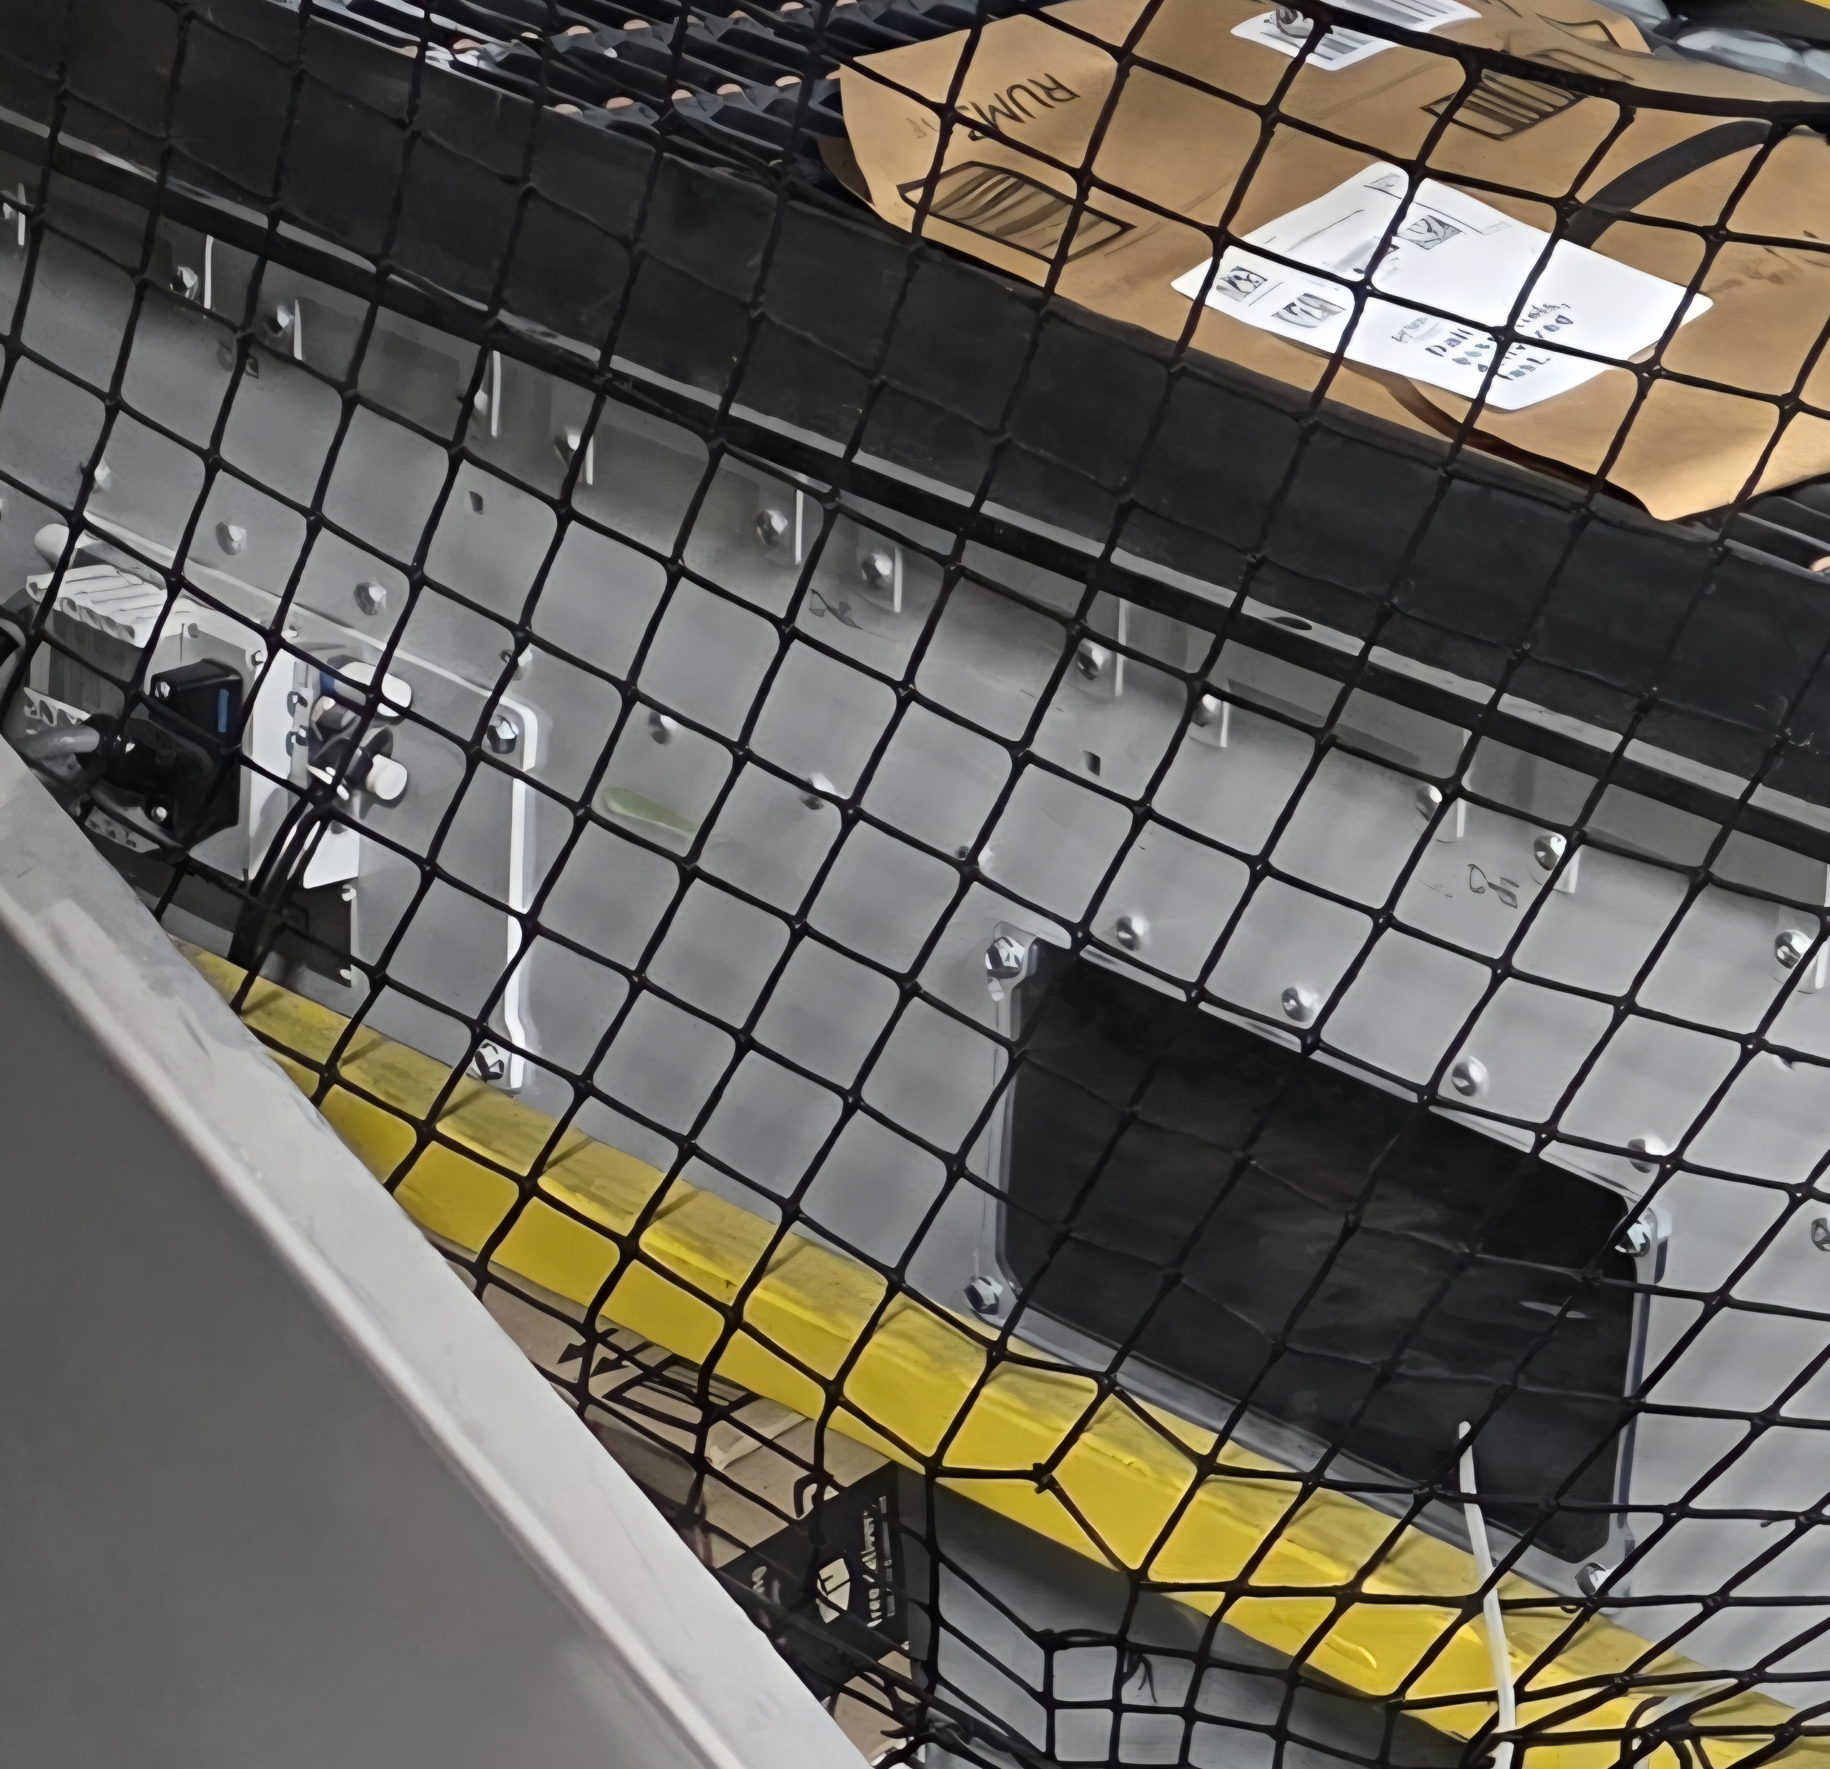

01 · THE PROBLEM
Insufficient Guard Rail → Packages Fall Off
Notes:
Existing guard rail fails: bows outward from thin metal + too short for tall packages. Focus on worst ~80-inch section. Photo shows the bowing problem.

Slide 4
02 · BY THE NUMBERS
How Often Does This Happen and what does it mean?
~25
~$22K
~8,800
Packages dropped per day
Estimated annual cost
Estimated packages per year
Based on 82 shift reports
At $2.50/package (likely more)
Simple average across all SLAM lines
82 shift reports documented 1,017 packages on the floor across all SLAM lines. Average: ~12.4 packages/shift × 2 shifts × 355 days = ~8,800/year × $2.50 = ~$22,000/year.
Source: #tpa4-dea-risk Slack channel (Feb 15 – Aug 2, 2026). 82 shift reports, 1,017 total drops observed (FHN shift only) — 2× shift multiplier applied.
Notes:
Statistics slide - placeholder values for Johnny to fill in with actual observed data on package falloff frequency, retrieval time, and weekly event count.

Slide 5
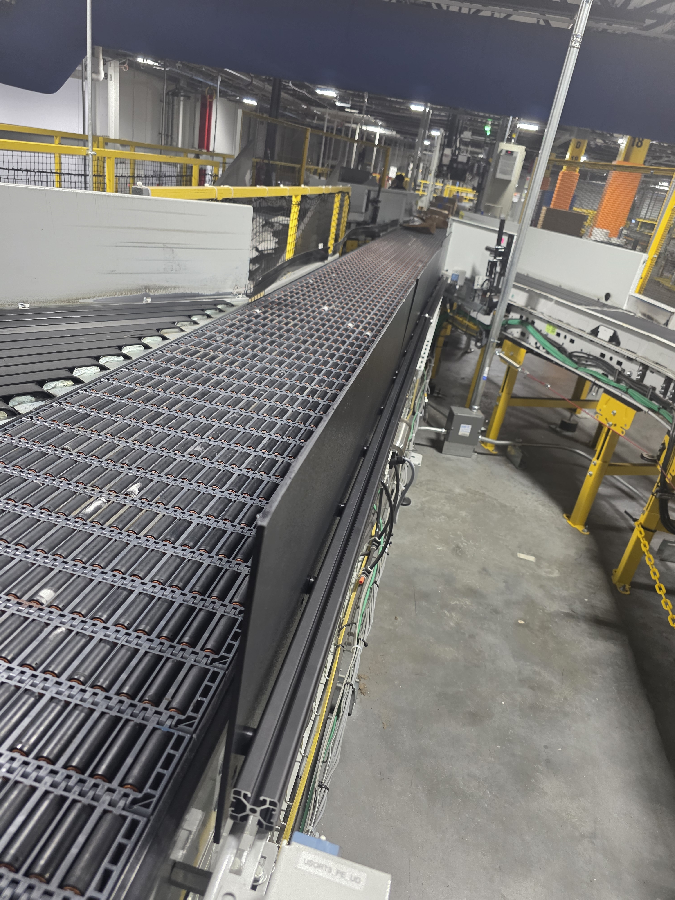
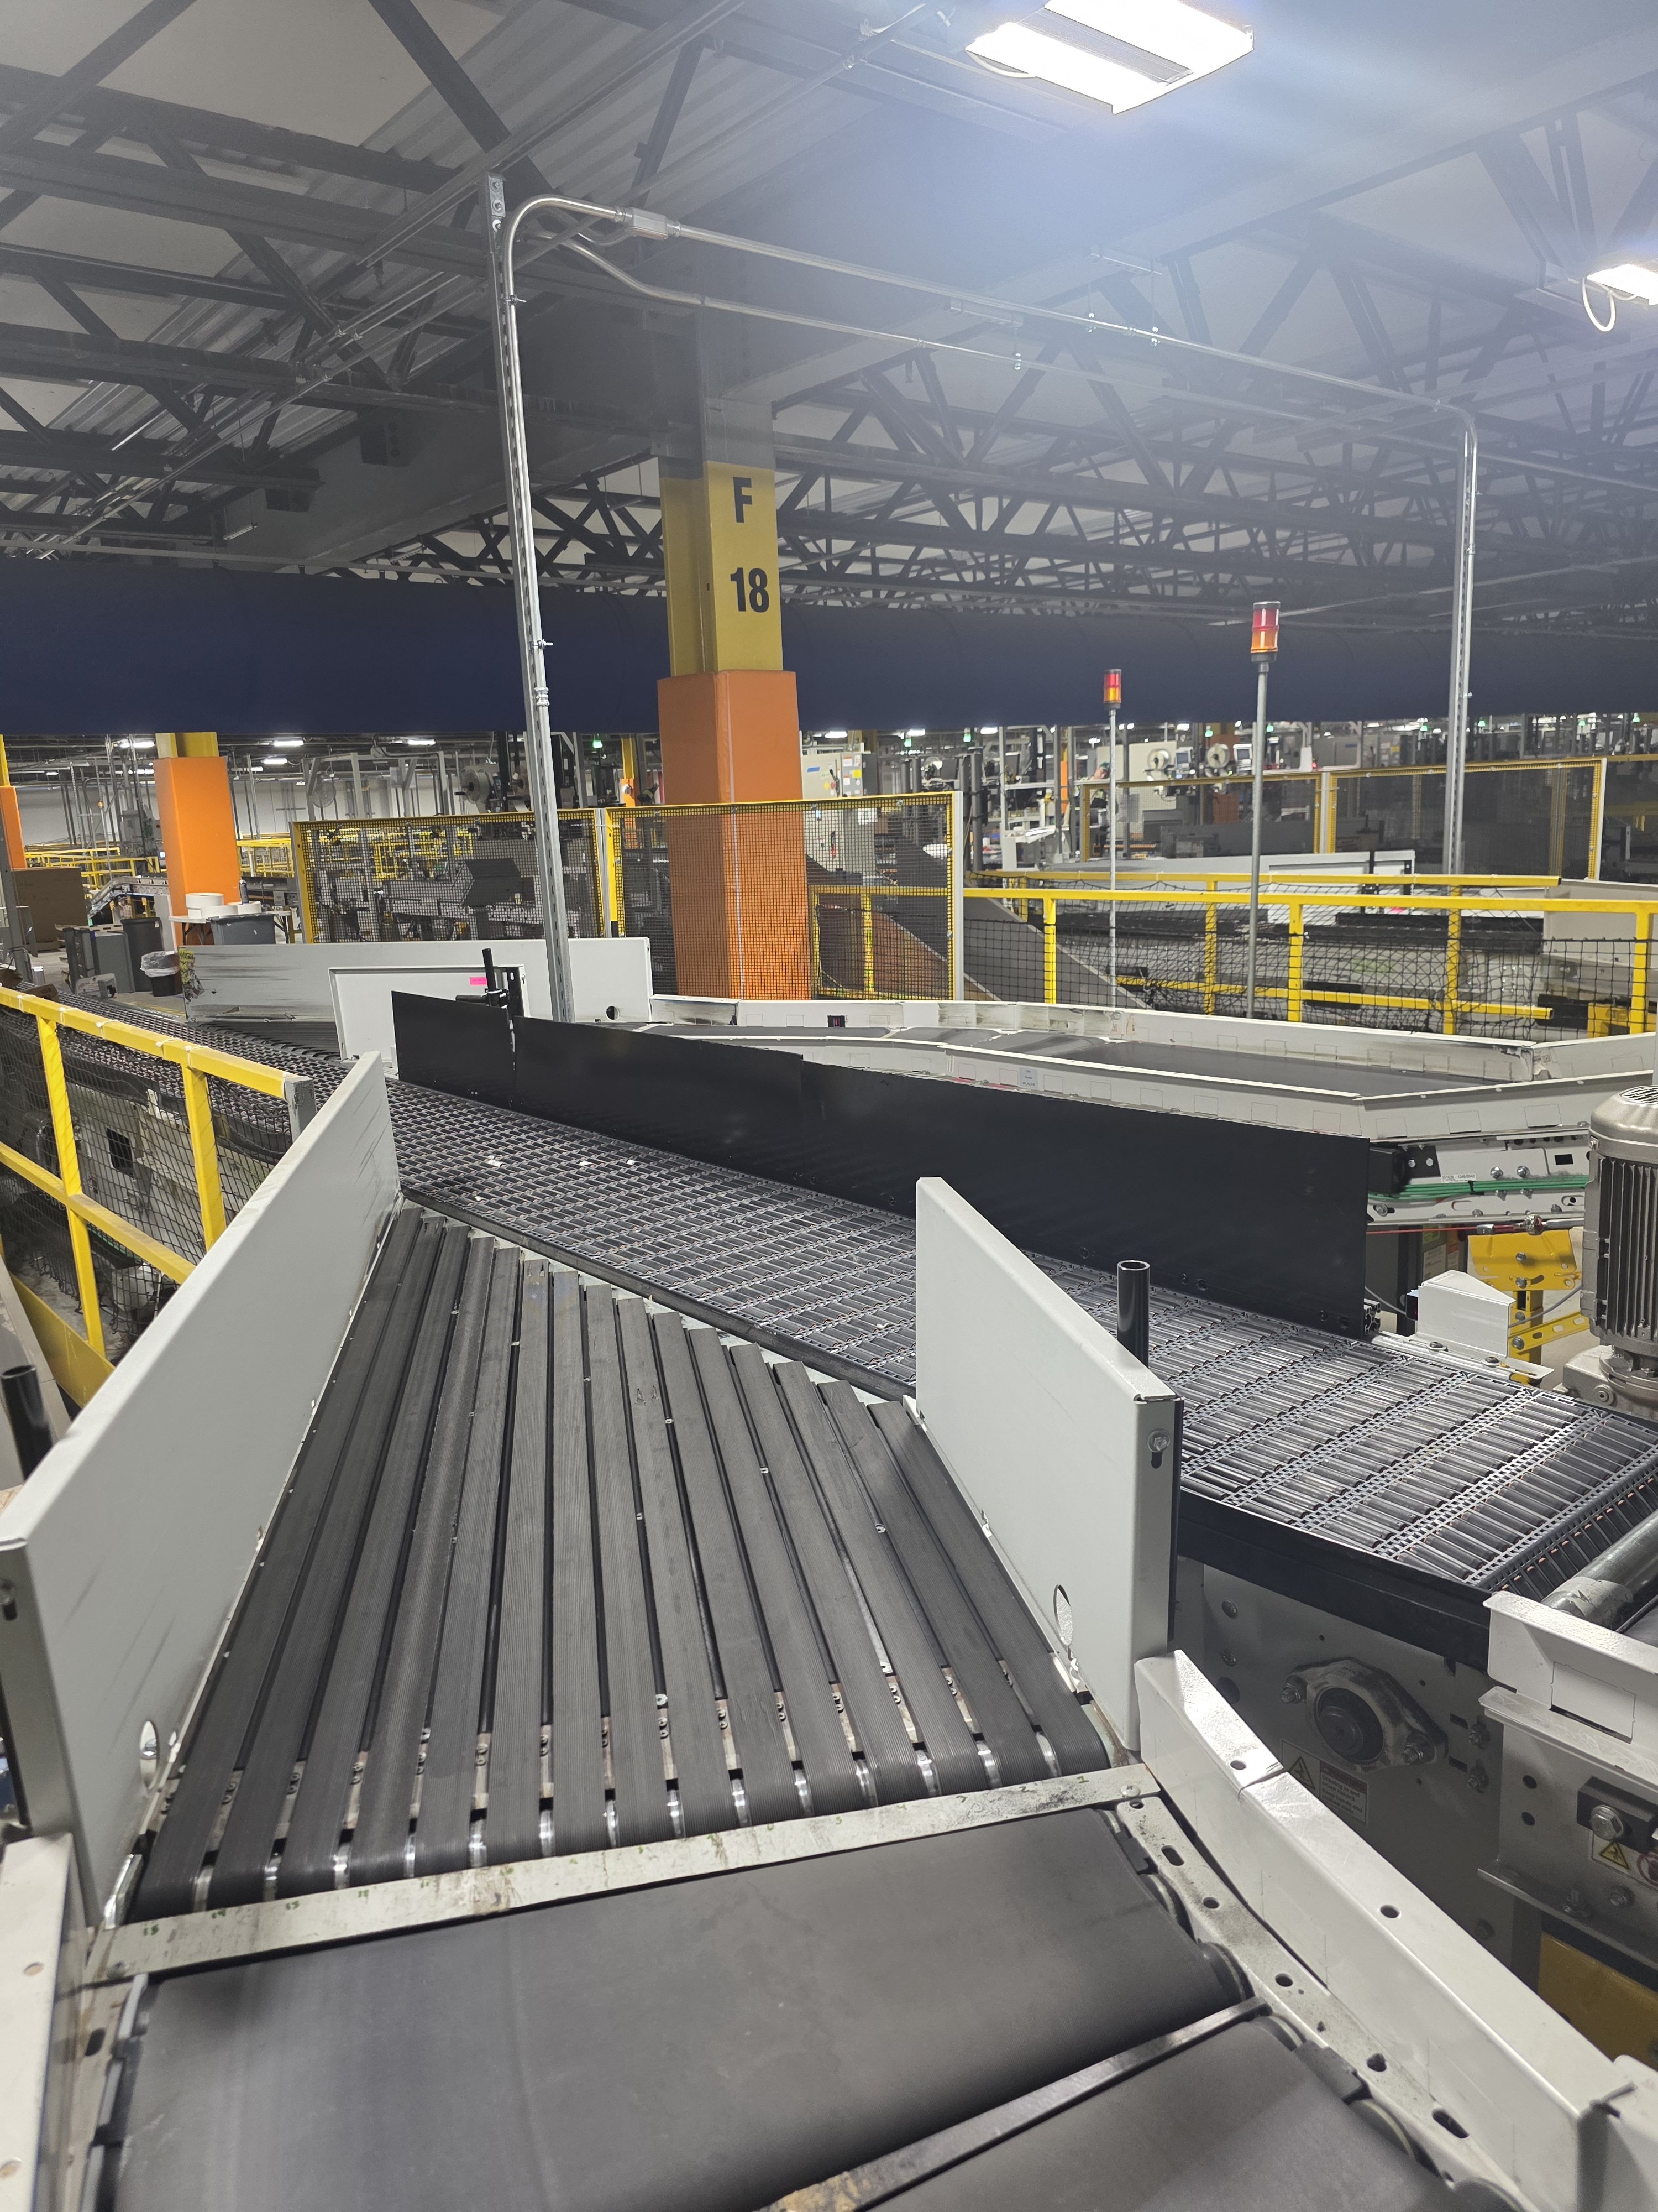
03 · THE SOLUTION
Installed Guard Rail Assembly
BEFORE
AFTER
Notes:
Side-by-side comparison: old bowing rail vs new 4040 extrusion solution. Visual proof of the improvement.

Slide 6
04 · DESIGN REQUIREMENTS
Requirements & Constraints
Containment
Serviceability
Rigidity
Prevent packages from falling off the conveyor or tipping over the guard rail
Easy removal for machine servicing
Must not bow outward under repeated impacts
Adaptability
Budget
Procurement
Same components can be sized and used across various sized sections
Total material cost no more than $250 per section
All materials through Coupa-approved channels
Notes:
Six key requirements: containment, serviceability, ~80in unsupported span, rigidity against bowing, taller height, under $300 budget, Coupa procurement.

Slide 7
05 · CONCEPT EVALUATION
Decision Matrix — 8 Concepts Evaluated
8 concepts scored across 6 criteria:
Most important: Structure, Serviceability, Safety
Also considered: Simplicity, Cost, Durability
SELECTED
ABS on 4040
Extrusion
Rank | Concept | Score
1 | ABS on 4040 Extrusion | 71 / 75
2 | ABS on 2040 Extrusion | 57 / 75
3 | Elastic Band | 46 / 75
3 | Folding Wall Panel | 46 / 75
5 | Sliding Panel | 44 / 75
6 | Retractable Belt | 43 / 75
7 | Hybrid Roller/Barrier | 38 / 75
8 | Roller Board | 33 / 75
71 / 75
94.7%
Scored highest across
all high-weight criteria:
Structure, Serviceability, Safety
Notes:
Decision matrix: 8 concepts evaluated against 6 weighted criteria. ABS on 4040 scored 71/75 (94.7%), dominating all high-weight categories. Runner-up 2040 scored 57/75.

Slide 8
06 · PROFILE EXPLANATION
What Are 2040 & 4040 Extrusions?
These numbers refer to the cross-section dimensions (in mm) of standard aluminum T-slot extrusions
2040
4040
40 mm
40 mm
20 mm
40 mm
Notes:
Explains 2040 vs 4040 aluminum extrusion profiles. 2040 = 20x40mm rectangular, 1 T-slot per side. 4040 = 40x40mm square, 2 T-slots per side. 4040 has 4.8x the moment of inertia.

Slide 9
07 · STRUCTURAL ANALYSIS
Why 4040 Over 2040 extrusions?
P ↓
δ = PL³ / 48EI
6063-T5 Aluminum | E = 68.9 GPa
L/240 limit ≈ 8.5 mm max deflection
↓ δ (deflection)
 | 2040 Profile | 4040 Profile ✓
Moment of Inertia (I) | 15,500 mm⁴ | 74,200 mm⁴ (4.8×)
Typical Load (20 lbf) | 12.71 mm deflection | 2.66 mm deflection
Worst-case (50 lbf) | 31.77 mm ✗ FAILS | 6.64 mm ✓ PASSES
Factor of Safety | 1.0 (marginal) | 5.0 (robust)
L/240 Check (~8.5 mm) | FAILS | PASSES
Notes:
Deflection diagram shows how a beam bows under load. The 4040 provides 4.8x the stiffness of 2040, achieving FOS 5.0 vs 1.0. Key decision: same concept, vastly different structural performance.

Slide 10
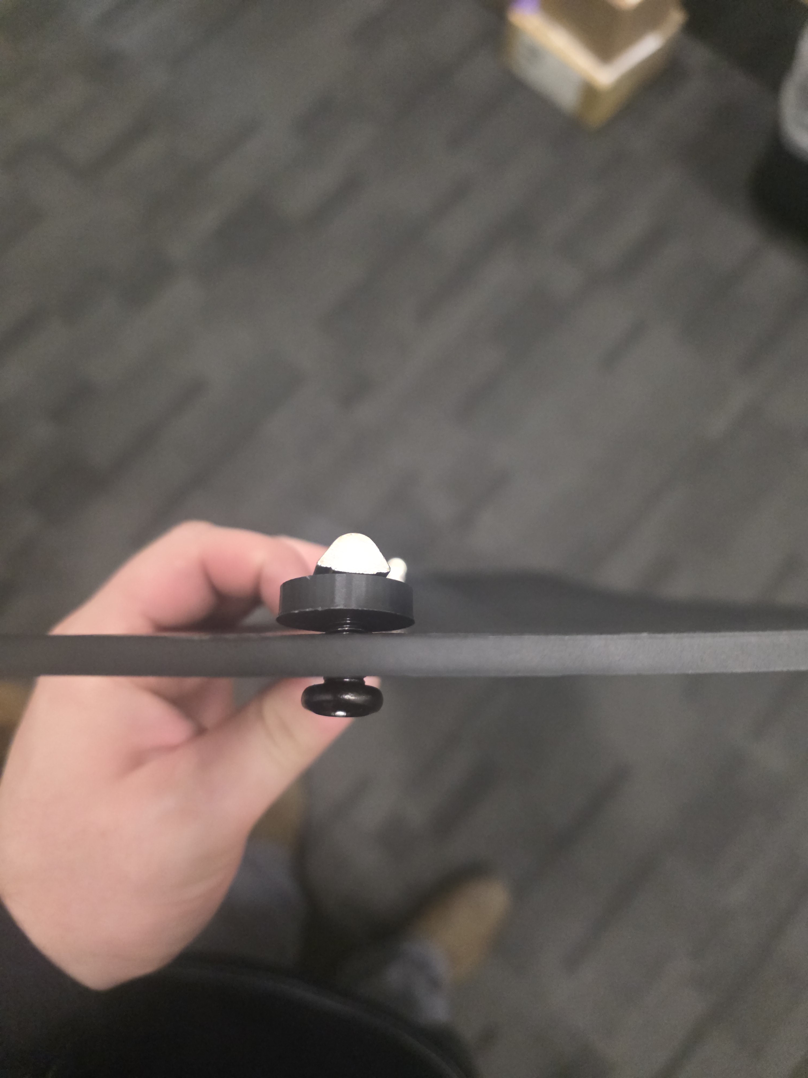
08 · THE PRIMARY COMPONENTS
What Makes Up the Assembly
T-Nut
PLA Spacer
ABS Panel
M8 Bolt
4040 Aluminum Extrusion
ABS Panel
3D-printed Spacers
M8 Bolts + T-Nuts
Notes:
Direct mounting eliminates custom brackets. M8x16mm button head screws pass through existing slotted holes into drop-in T-nuts. Photo placeholder for actual bracket attachment.

Slide 11
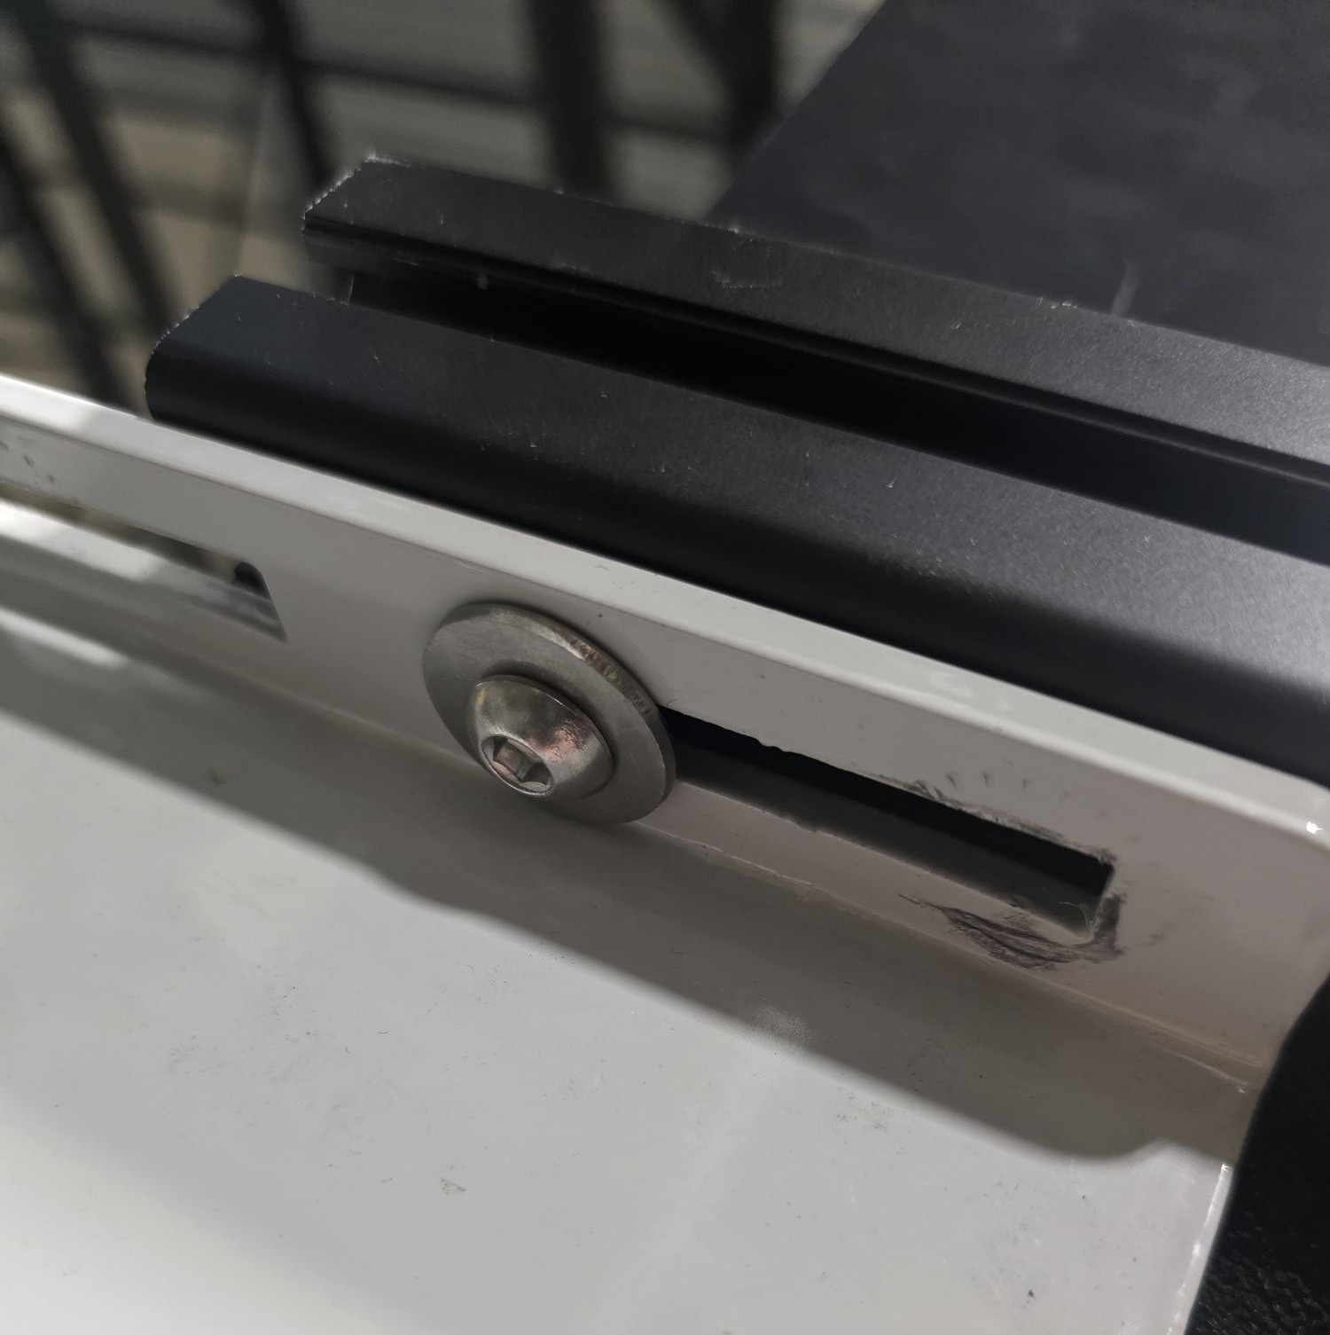
09 · INSTALLATION METHOD
Direct Bracket Attachment
Key Design Decisions:
• M8 button head screws pass upward from below and through existing slots
• Threads into 40-series drop-in T-nuts seated in bottom channel of the extrusion
• One bolt on each end of the assembly
• Attaches directly to existing conveyor brackets
Notes:
Direct mounting eliminates custom brackets. M8x16mm button head screws pass through existing slotted holes into drop-in T-nuts. Photo placeholder for actual bracket attachment.

Slide 12
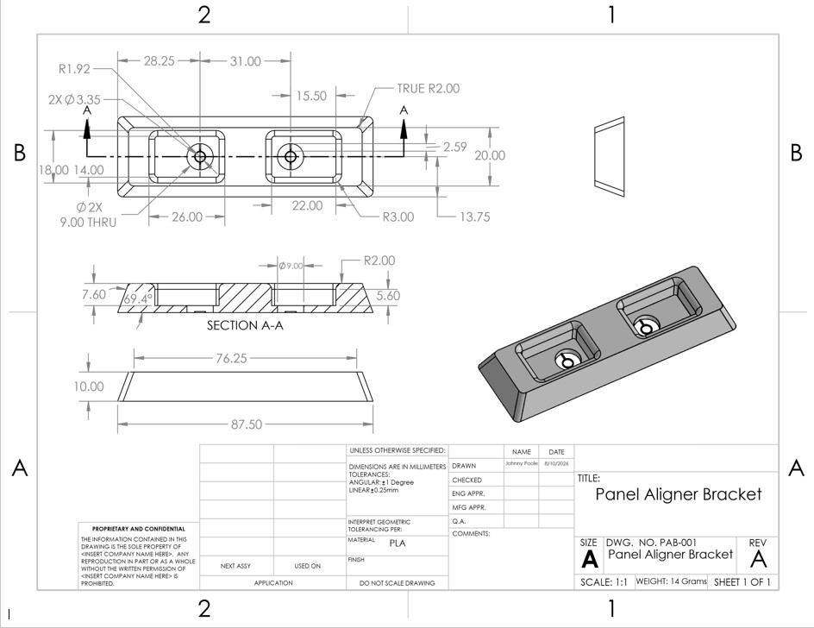
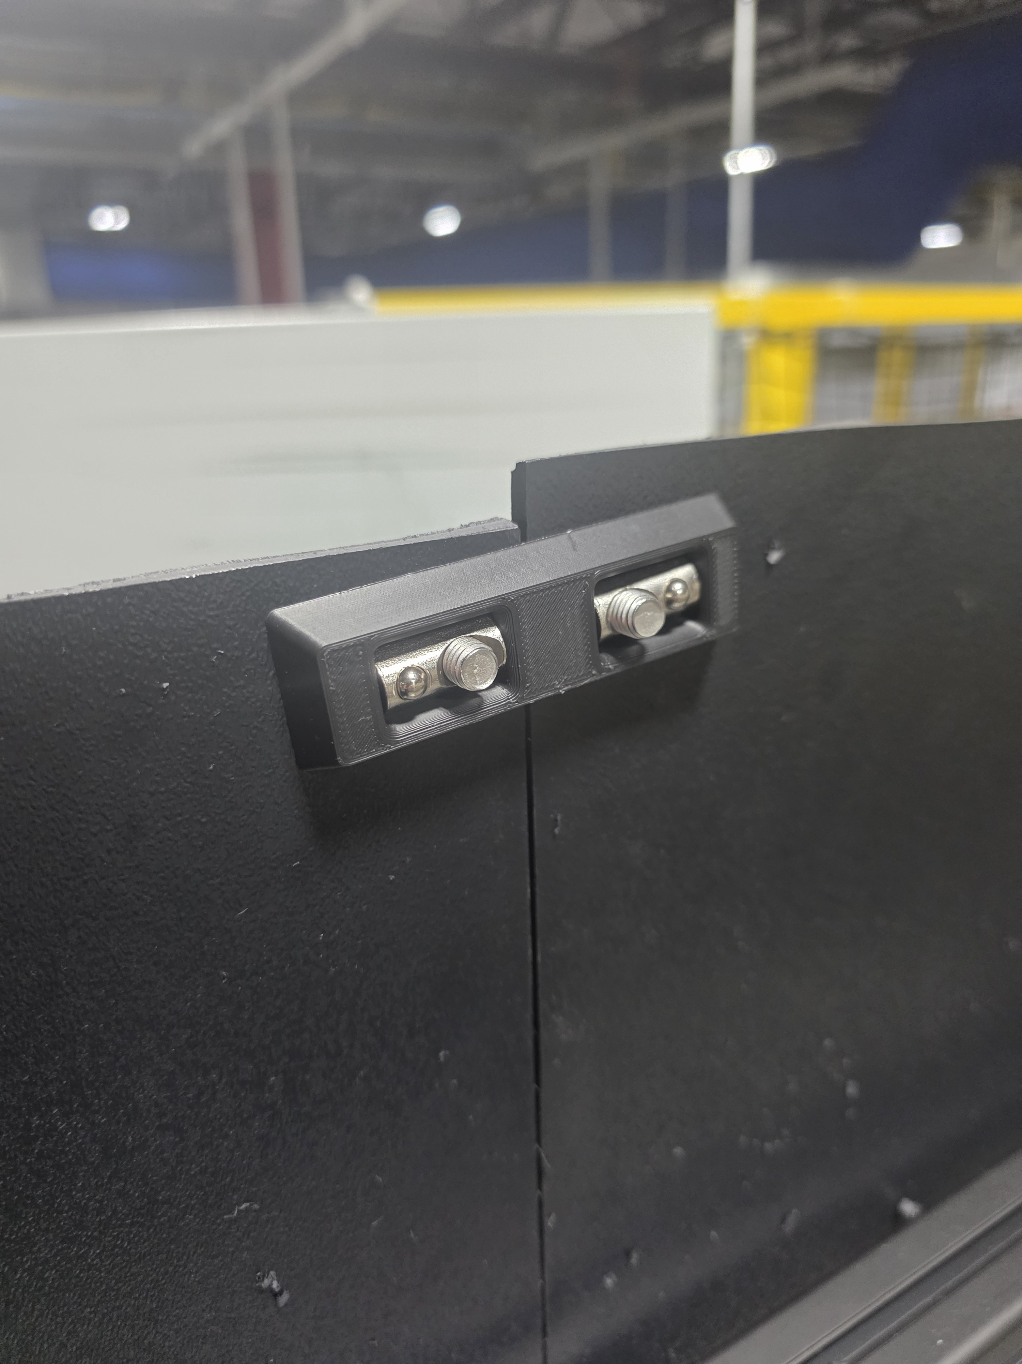
10 · PANEL ALIGNER BRACKET
Notes:
Direct mounting eliminates custom brackets. M8x16mm button head screws pass through existing slotted holes into drop-in T-nuts. Photo placeholder for actual bracket attachment.

Slide 13
11 · RESULTS
Post-Installation Validation
BEFORE
AFTER
2.3
1.2
→
packages fallen per day
packages fallen per day
Line 501 average across 32 reporting days
Line 501 average across 8 reporting days
47% reduction – exceeds expected 33% from installing the assembly to 1 of 3 sections on line 501
Notes:
Post-installation results. Replace [X] with actual observed data showing reduction in package falls.

Slide 14
12 · RETURN ON INVESTMENT
Cost vs. Savings at Every Scale
THIS INSTALL
1 of 3 gaps, Line 501
FULL LINE 501
All 3 gaps covered
FACILITY-WIDE
All sections
Cost
$198
Cost
~$594
Cost
~$5,346
Annual Savings
~$1,918/yr
Annual Savings
~$4,081/yr
Annual Savings
~$22K/yr
Payback Period
~38 days
Payback Period
~53 days
Payback Period
~89 days
Based on $2.50/package DEA miss cost. True cost including RME labor + customer concessions likely $4.50–$7.00+ per package.
Notes:
Side-by-side comparison: old bowing rail vs new 4040 extrusion solution. Visual proof of the improvement.

Slide 15
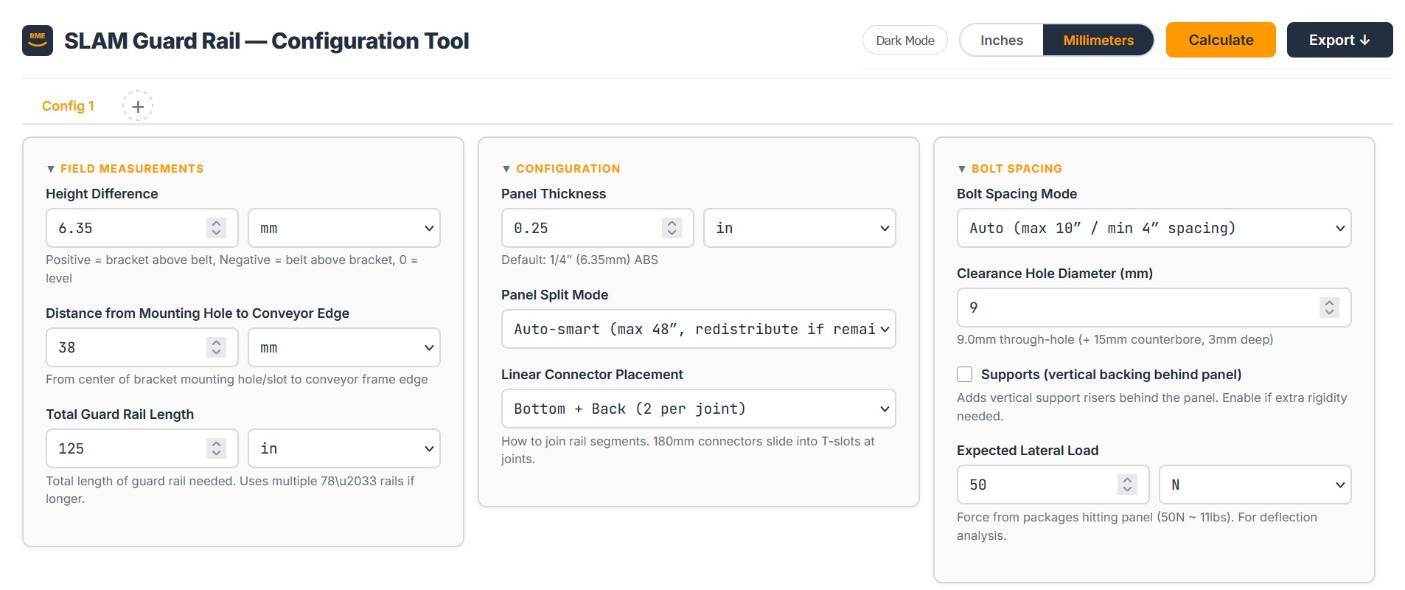
13 · CONFIGURATION TOOL
Guard Rail Configuration Tool
Browser-based calculator for configuring guard rail installs at any SLAM line location.
Input bracket measurements → tool auto-generates:
• Drill positions & hole layout
• Panel and rail segment splits
• Complete bill of materials & cost
• Real-time deflection analysis (FOS)
• T-nut position map & cut list
HTML/JS
Multi-Tab
PDF/Excel
Zero Install Required
Multiple Section Outputs at a time
Export Ready

Slide 16
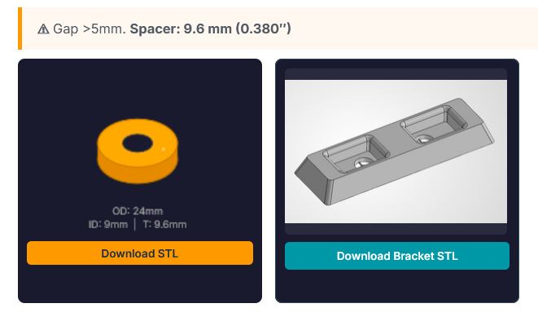
14 · CONFIGURATION TOOL
Auto-Generated 3D Print Files
Auto-generates an STL file for the required spacer based on input measurements
The STL file for the panel aligner bracket can also be downloaded directly from the configuration tool
This completely eliminates the need for 3D modeling!

Slide 17
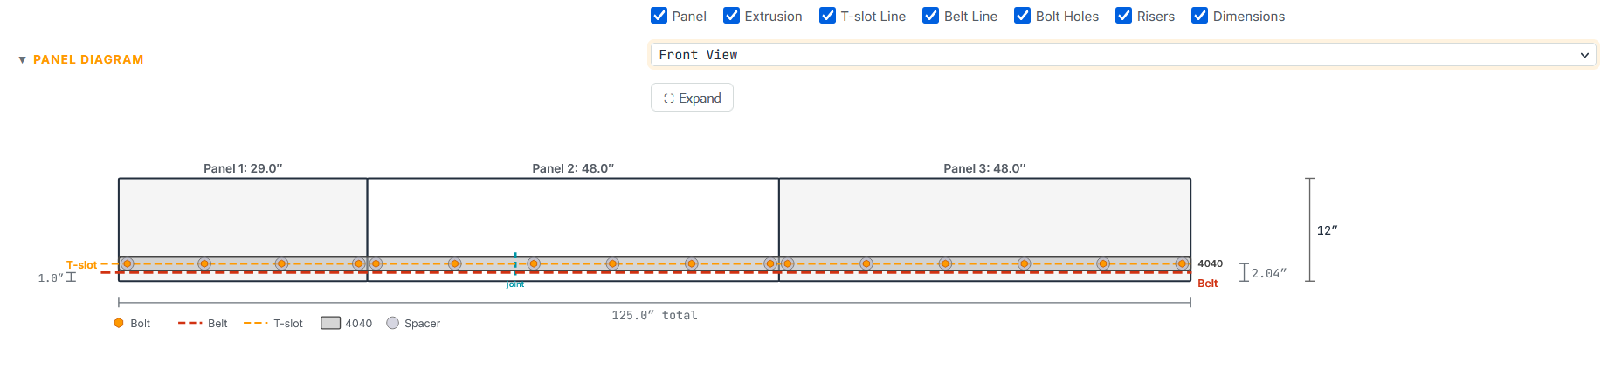
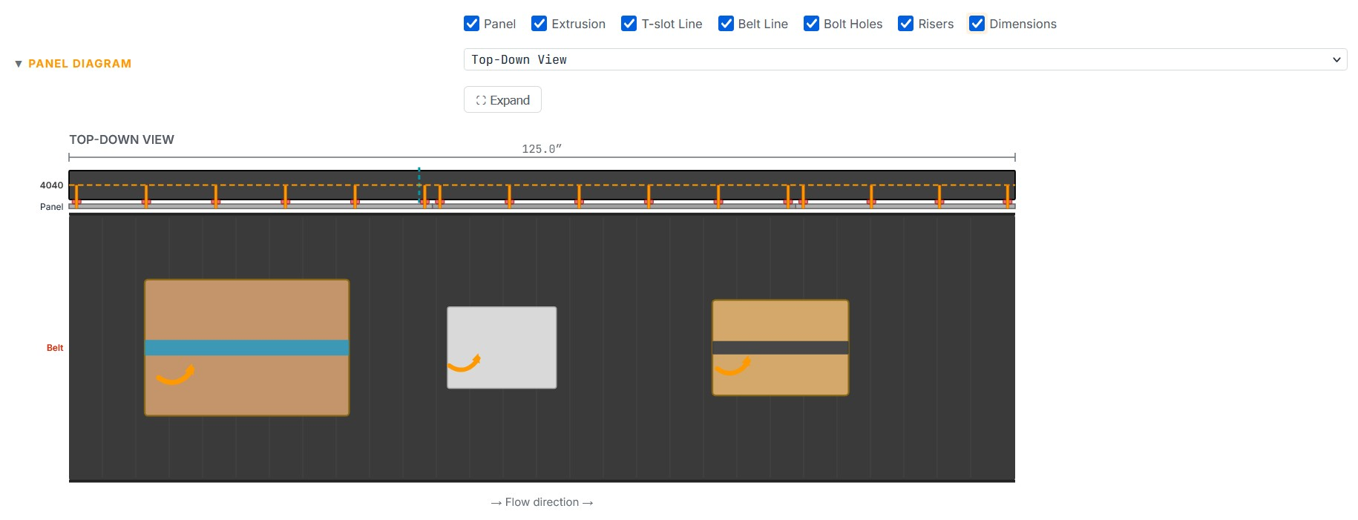
15 · CONFIGURATION TOOL
Assembly Views

Slide 18
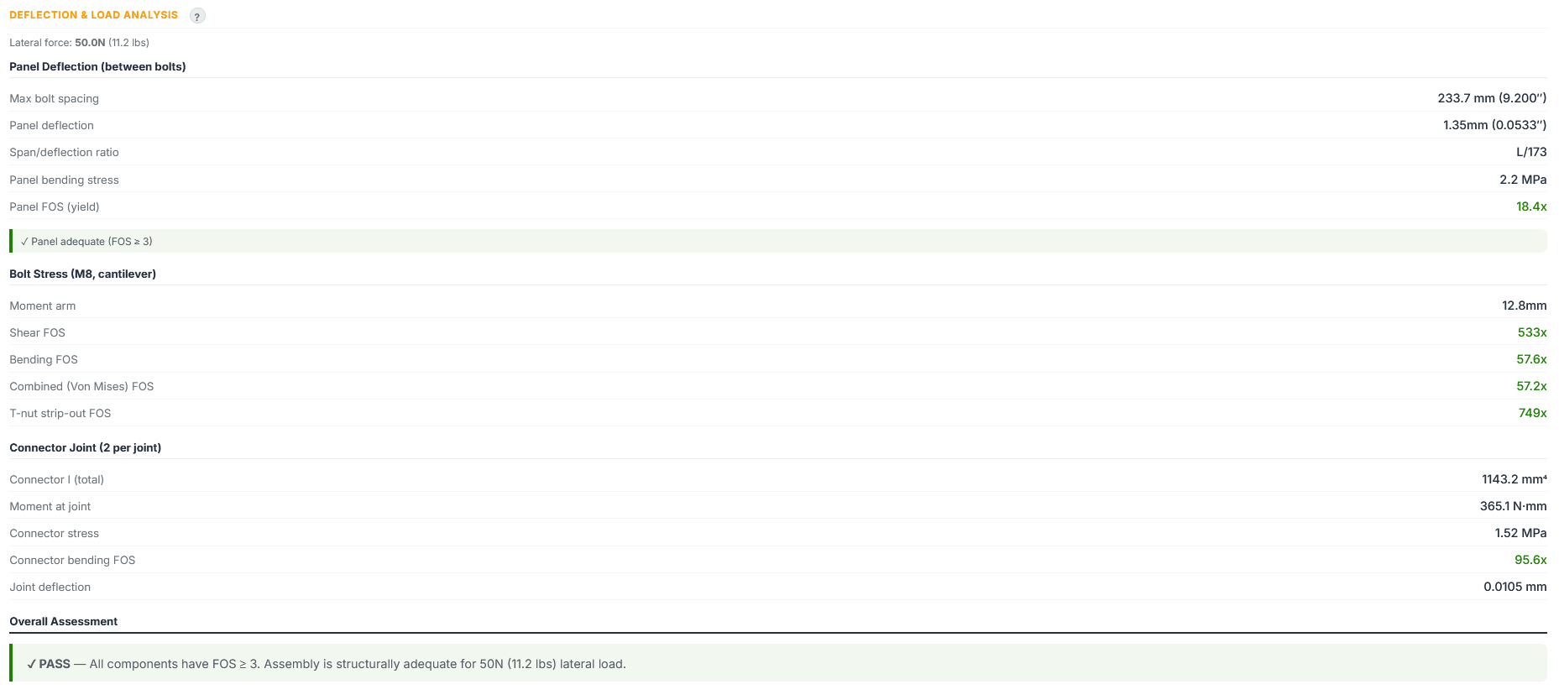
16 · CONFIGURATION TOOL
Factor of safety Calculations

Slide 19
17 · LOOKING AHEAD
Phase 2: Facility Rollout
Phase 1 — COMPLETE
✓ Prototype installed on Line 501
✓ Drop reduction validated
✓ Configuration tool built
✓ Handoff document completed
Phase 2 — NEXT
Technicians install assemblies on
remaining SLAM line sections
• Use config tool for each section
• Handoff document has necessary info
Notes:
Scalability: same design applies to remaining 45 in of the 125 in rail and other conveyor sections. Modular, standard hardware, Coupa-sourced.

Slide 20
Thank You
Thank You
Questions?
Johnny Poole | AMM Intern, RME
Mentor: Kishan Patel | Manager: Jon Templeton
TPA4-SFC • August 2026
Notes:
Acknowledgments: Kishan Patel (mentor), Jon Templeton (manager), and others who supported the project. Add names as needed.

